Slide 1
DirectX Coursework Presentation
By Michael Little

Slide 2
Intro
For our Coursework we were asked to create a scene in DirectX 11 that shows off:
our knowledge of DirectX and its features
be well structured and commented.
This presentation is to Highlight three major components of the scene and how I accomplished these and conclude with my own personal thoughts.

Slide 3
Components
My scene is composed of several components but I’m choosing to focus on the following.
1: Vertex Manipulation
2: Shaders
3: Billboarding

Slide 4
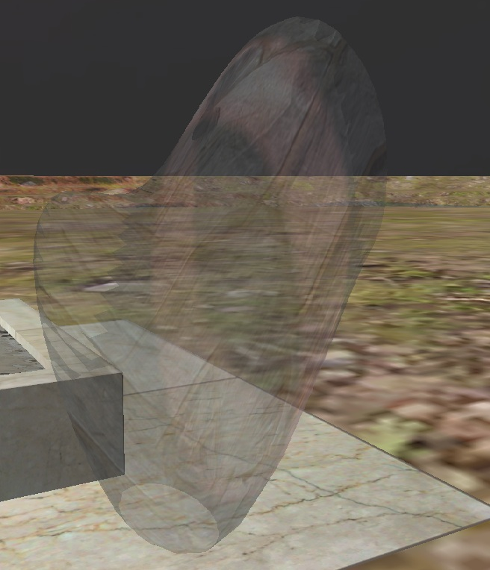
1. Vertex Manipulation
For my scene I make use of two different types of Vertex Manipulation:
Ocean Shader
Terrain Generation
Ocean
The first involves taking a plane/model and manipulating its vertexes by moving them based on values generated by a cosine wave.
//offset position based on sine wave
input.position.y += waveHeight*sin(input.position.x + time);

Slide 5
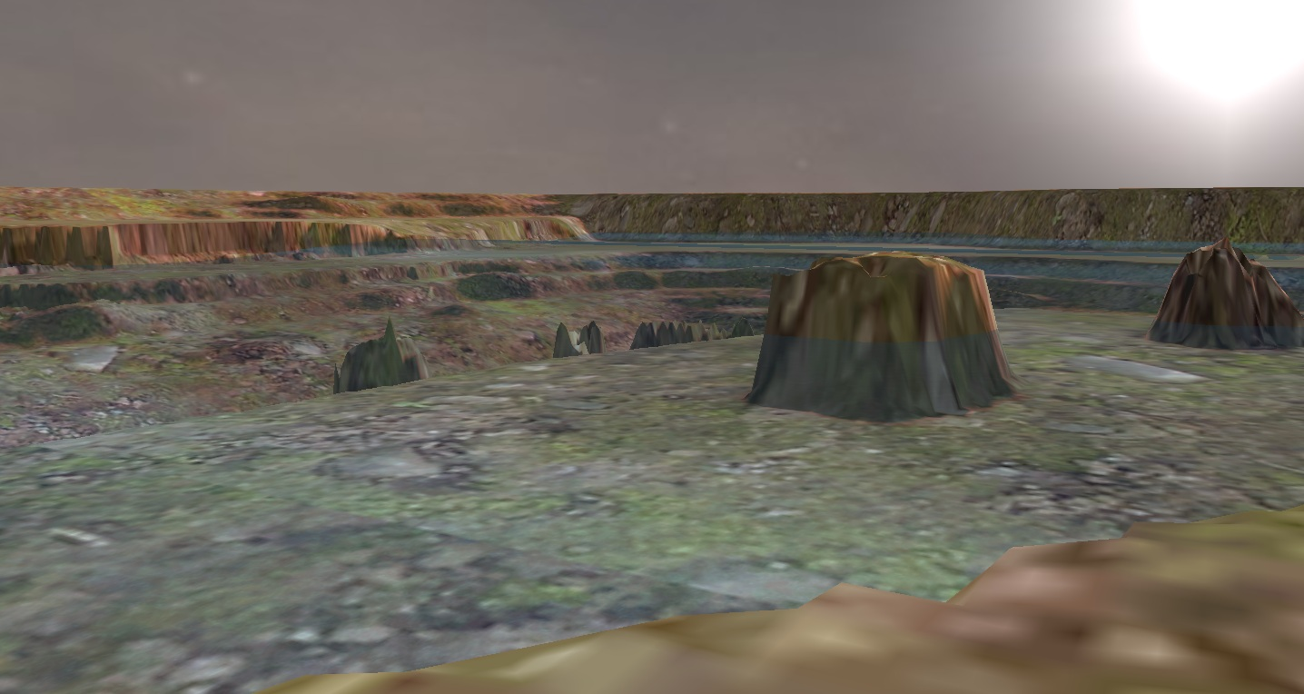
Terrain Generator
The Terrain Generator uses a Heightmap to determine the location of the vertexes when generating a plane, each pixel in the original image represents a quad in DirectX, and the lighter the colour the higher the position.
// Sample the pixel color from the texture using the sampler at this texture coordinate location.
textureColor = shaderTexture.Sample(SampleType, input.tex);

Slide 6
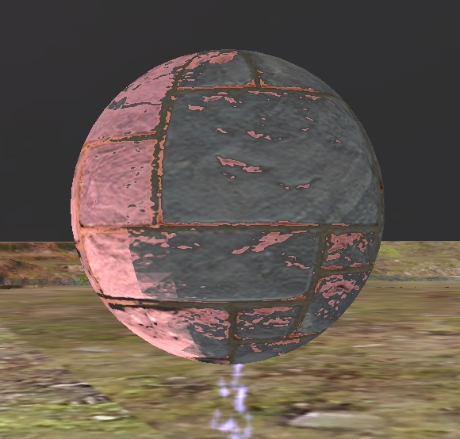
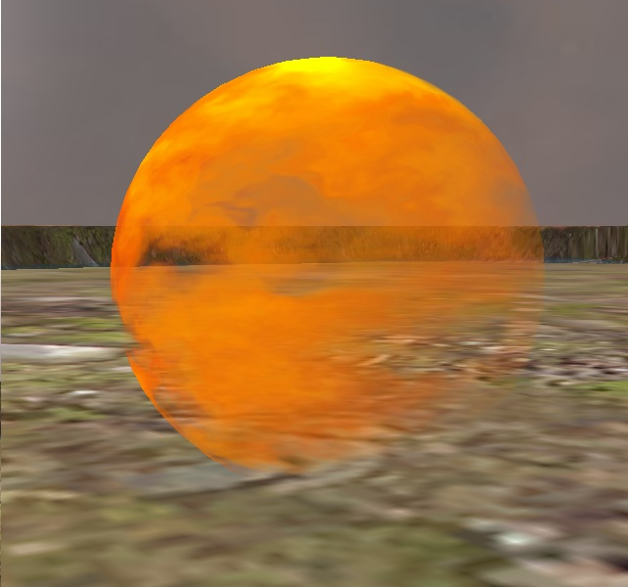
2. Shaders
For the Scene I implemented several different shaders to show off all the various abilities of DirectX
Bumpmap
The Bumpmap shader takes in two textures and uses the second to determine how the light affects it, this gives the impression that the object isn't flat.
Fire
The Fire Shader takes in 3 textures and uses them to create the illusion of fire, the first one is used to move the fire, the second is the actual texture, and the third determines the alpha of the texture.

Slide 7
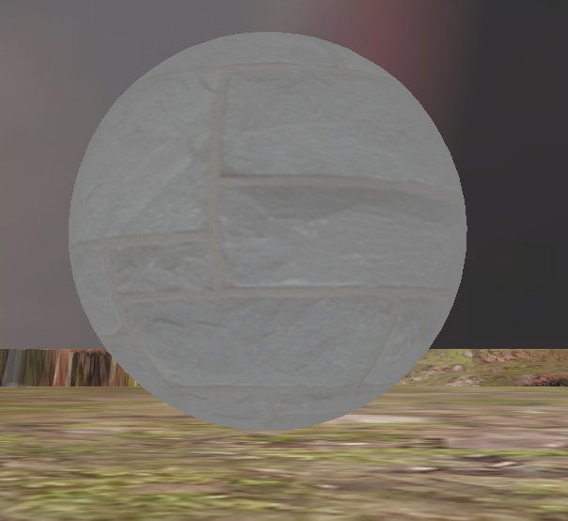
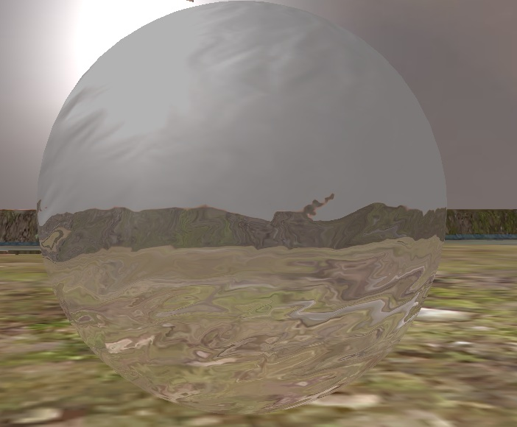
Fog
The Fog shader takes in the model’s position and the cameras position and uses them to determine the distance between them, and then use it to affect how clear the texture is.
Refraction
The Refraction Shader is used to simulate small bodies of water as it takes objects rendered in the “render refraction to Texture” function and distorts them using a moving transparent texture that gives the impression that your looking at water.

Slide 8
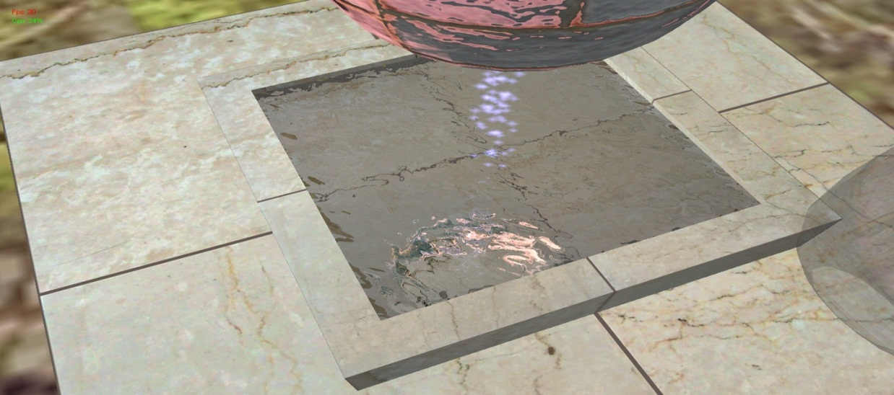
Billboarding
Billboarding is a function that takes the position of the camera and the position of the model to determine the angle and then rotate the model to face the camera, this is useful for 2D objects as it gives the impression that they’re 3D, this was used in games like doom to allow them to have 2D objects in a 3D scene.
/ Calculate the rotation that needs to be applied to the billboard model to face the current camera position using the arc tangent function.
angle = atan2(modelPosition.x - cameraPosition.x, modelPosition.z - cameraPosition.z) * (180.0 / D3DX_PI);
I have used this on my Particles and fire shader to give the impression that they are 3D and always face the camera (even their reflections).

Slide 9
Conclusion
In conclusion creating this scene has been one of the most complicated and frustrating things I’ve ever worked on, that said seeing the final product does make it worth it as it is also one of the best looking things I’ve ever coded and the knowledge I’ve gained during this term with be invaluable to my future as a game developer.
In reflection while its has been a stressful module it is also been one of the most influential and will stay with/haunt me for years to come.
If I was to do this module again, I wouldn’t change much, except for maybe spend more time on implementing more features e.g. Shadow mapping. As well as improving my lighting and ocean to look more realistic, and incorporate more features such as post processing and multiple textures on my terrain.
But due to a lack of time I was unable to implement them successfully.

Slide 10
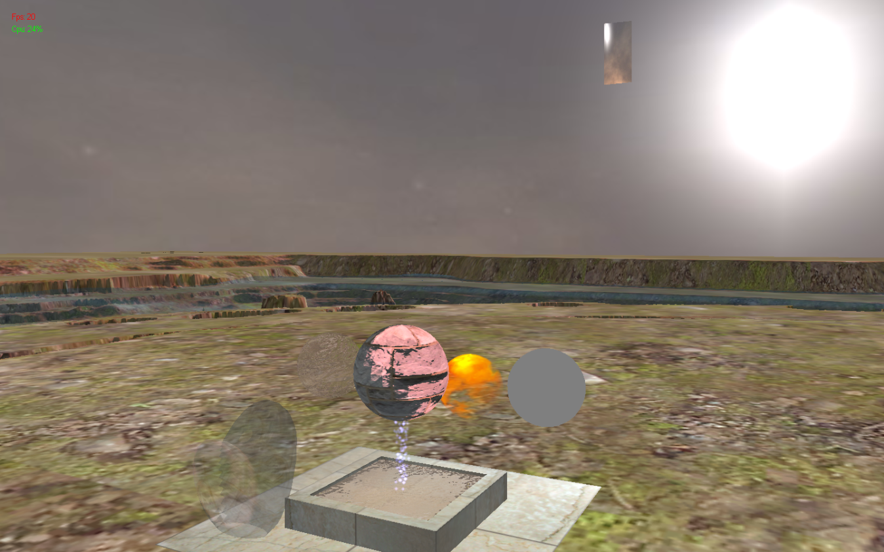
And Finally….
The final product.

Slide 11
Refrences
RasterTek - DirectX 10 and DirectX 11 Tutorials. 2014. RasterTek - DirectX 10 and DirectX 11 Tutorials. [ONLINE] Available at: http://www.rastertek.com/. [Accessed 12 January 2014].
Thanks to all my friends , teacher’s assistants and Lecturer for helping me!

